Slide 1
Pandas Data Visualization
Module 02
Data Science Developer

Slide 2
Pandas Data Visualization
In this lecture we will learn about pandas built-in capabilities for data visualization! It's built-off of matplotlib, but it baked into pandas for easier usage!

Slide 3

Imports

Slide 4
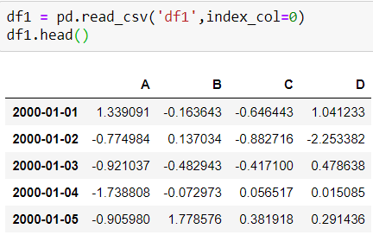
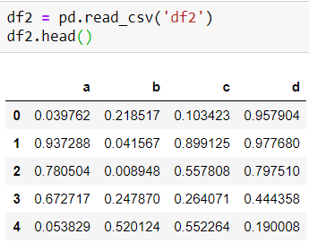
Data

Slide 5
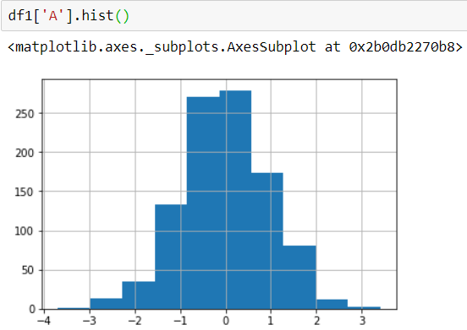
Style Sheets
Matplotlib has style sheets you can use to make your plots look a little nicer. These style sheets include plot_bmh, plot_fivethirtyeight, plot_ggplot and more.
They basically create a set of style rules that your plots follow. They make all your plots have the same look and feel more professional.
Here is how to use them.
Before plt.style.use() your plots look like this:

Slide 6

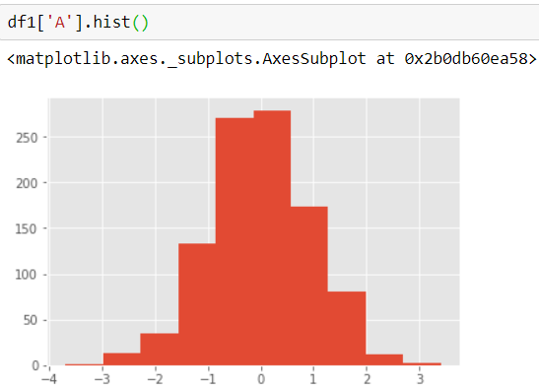
Call the style:
Now your plots look like this:

Slide 7
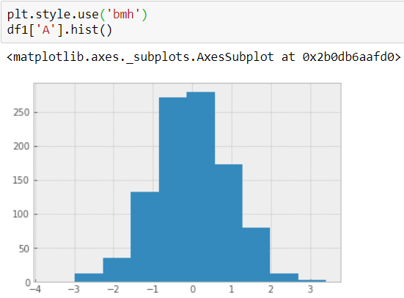
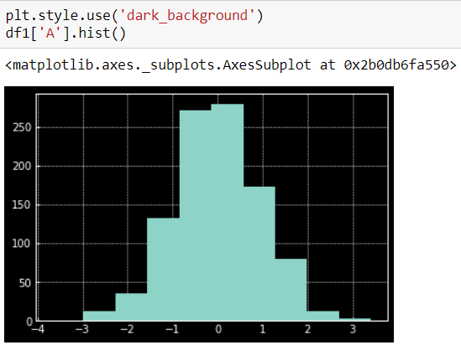

Slide 8
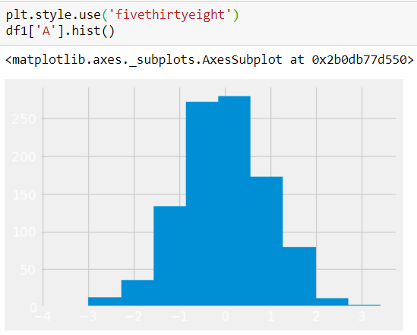

Let's stick with the ggplot style and actually show you how to utilize pandas built-in plotting capabilities!

Slide 9
Plot Types
There are several plot types built-in to pandas, most of them statistical plots by nature:
df.plot.area
df.plot.barh
df.plot.density
df.plot.hist
df.plot.line
df.plot.scatter
df.plot.bar
df.plot.box
df.plot.hexbin
df.plot.kde
df.plot.pie
You can also just call df.plot(kind='hist') or replace that kind argument with any of the key terms shown in the list above (e.g. 'box','barh', etc..)

Slide 10
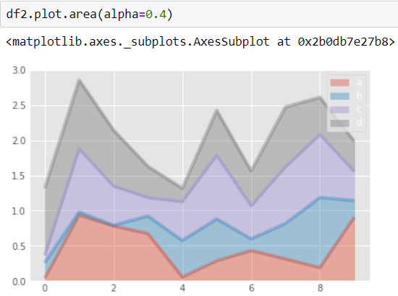
Area

Slide 11
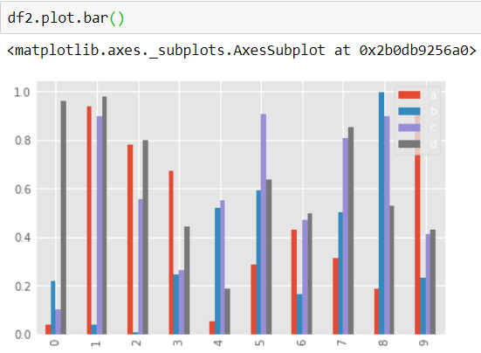
Barplots

Slide 12
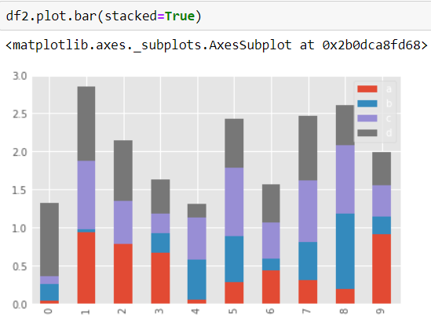

Slide 13
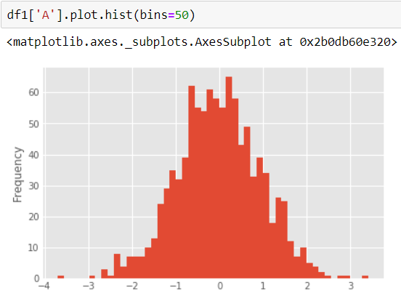
Histograms

Slide 14
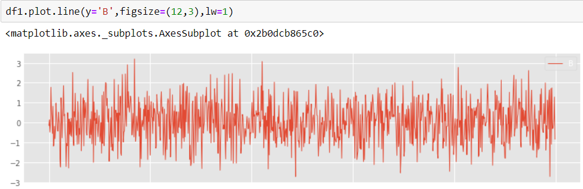
Line Plots

Slide 15
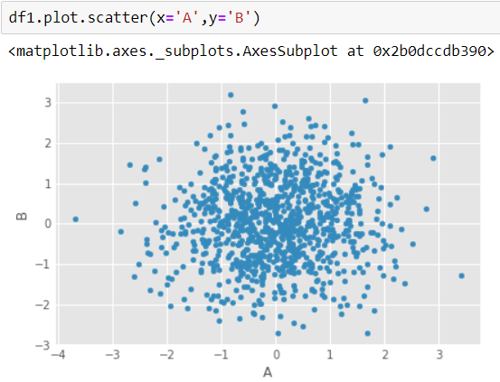
Scatter Plots

Slide 16
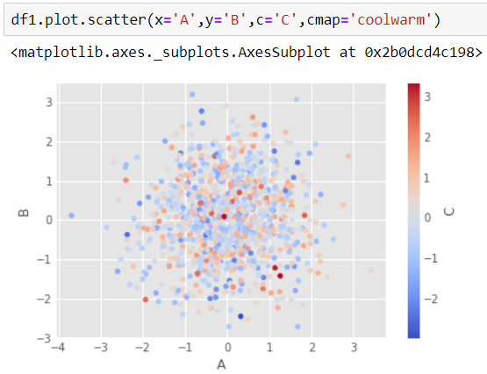
You can use c to color based off another column value Use cmap to indicate colormap to use. For all the colormaps, check out: http://matplotlib.org/users/colormaps.html

Slide 17
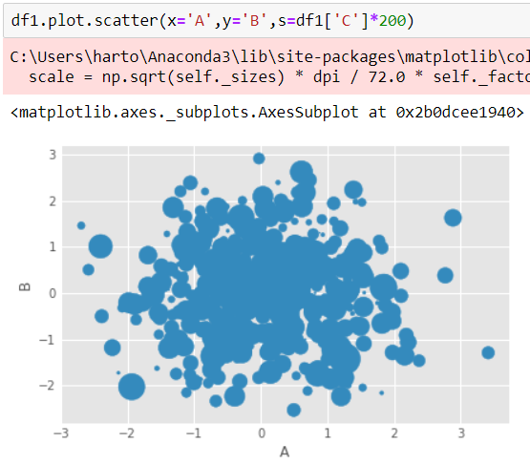
Or use s to indicate size based off another column. s parameter needs to be an array, not just the name of a column:

Slide 18
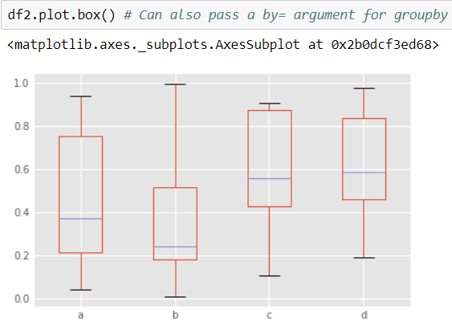
BoxPlots

Slide 19
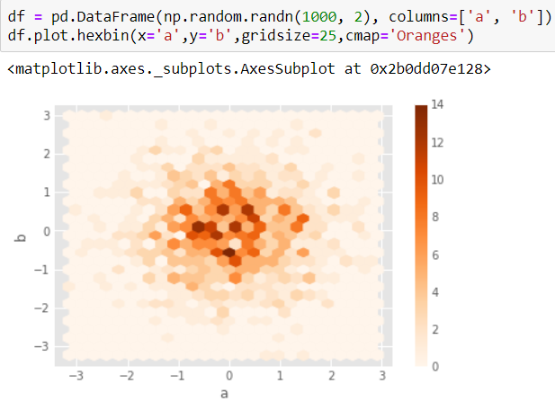
Hexagonal Bin Plot
Useful for Bivariate Data, alternative to scatterplot:

Slide 20
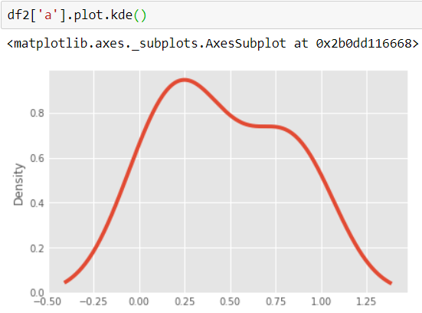
Kernel Density Estimation Plot (KDE)

Slide 21
